Slide 1

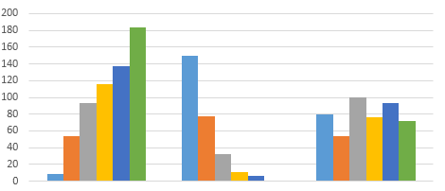
Project Presentation
CS523 - Big Data Technologies

Slide 2
Team
Eric Nelson Elem
Syed Quamruzzaman

Slide 3
Outline
Agenda
Project 1
Architecture
Component & Technologies
Project Demo
Code Walkthrough
Project 2
Theory
Demo
Q&A?

Slide 4
Project 1
Bitcoin Price Analysis
Based on coindesk’s rate we will analyze some aspects of Bitcoin price during specific time range
We will show some interactive real time graph
iAnalyzer

Slide 5
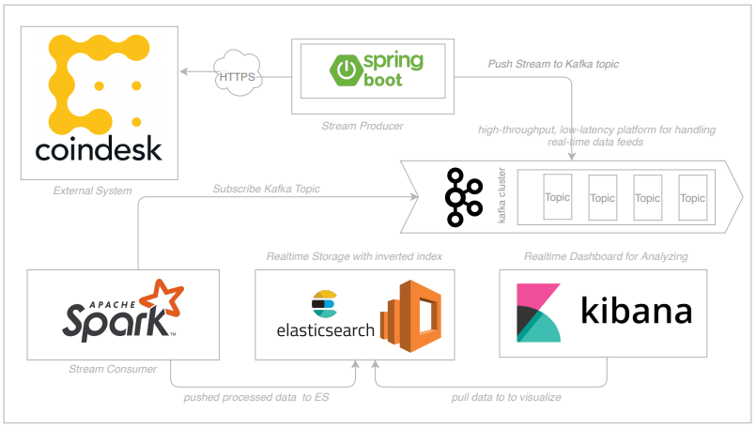
Highlevel Architecture
Architecture

Slide 6
Coindesk
External api service, we will consume one of their api to get Data
StreamProducer - This service will pull Bitcoin Price from External API and push this data to Kafka Stream periodically
Components
&
Technologies
Kafka - High-throughput, low-latency platform for handling real-time data feeds
StreamConsumer - Spark Job running here, here we have a subscriber of kafka topic, whenever there is a new stream available, it processed and send it to Elastic Search for storing.

Slide 7
Elastic Search
Elasticsearch is a search engine based on Lucene. It provides a distributed, multitenant-capable full-text search engine with an HTTP web interface and schema-free JSON documents.
Components
&
Technologies
Kibana - Kibana is an open source data visualization plugin for Elasticsearch. It provides visualization capabilities on top of the content indexed on an Elasticsearch cluster

Slide 8
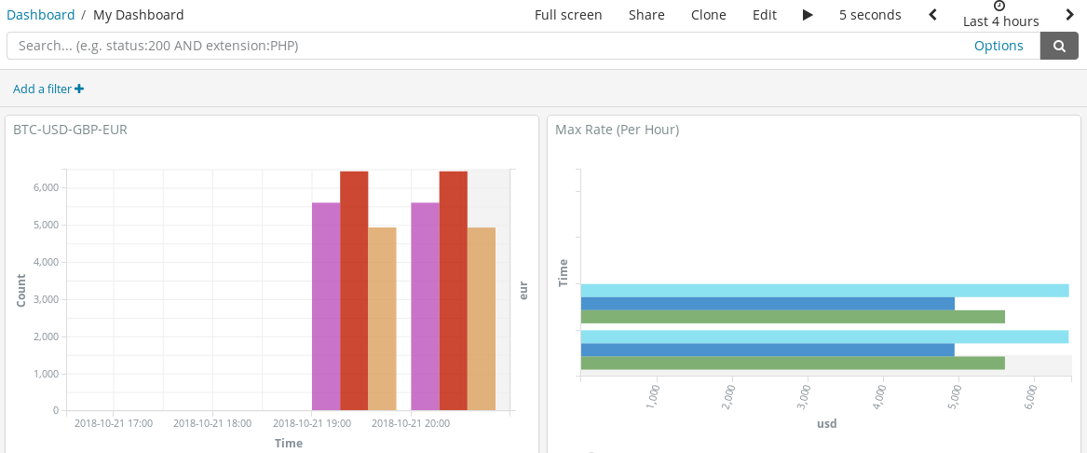
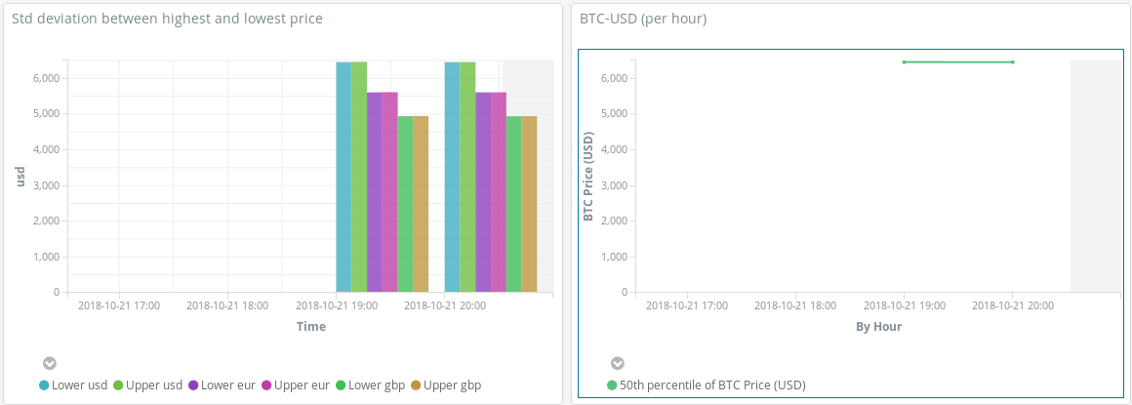
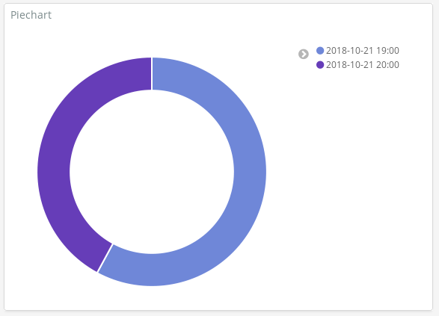
Real time Dashboard

Slide 9
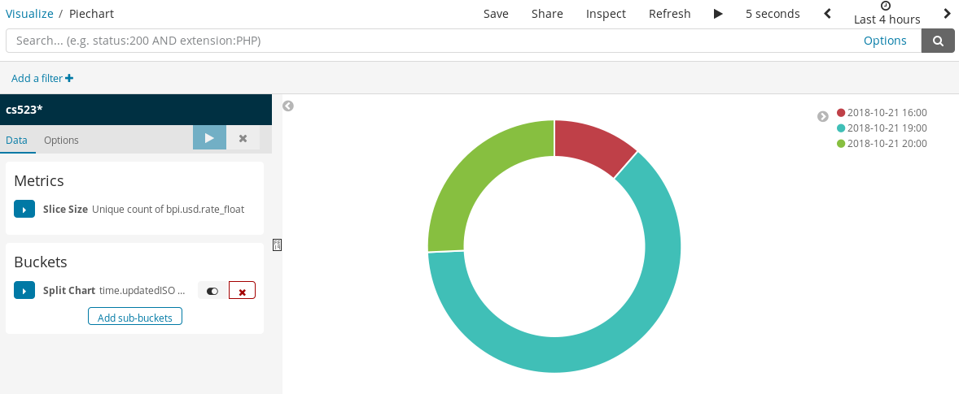
Showing specific
Currency was stable during one hour time interval against BTC
Pie Chart

Slide 10
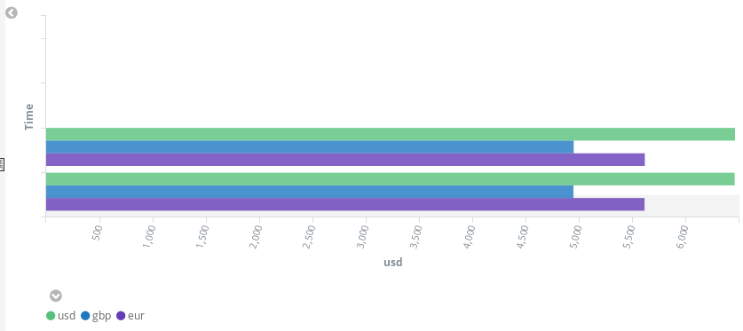
Per hour Max Rate of each currency against BTC
Bar Chart

Slide 11
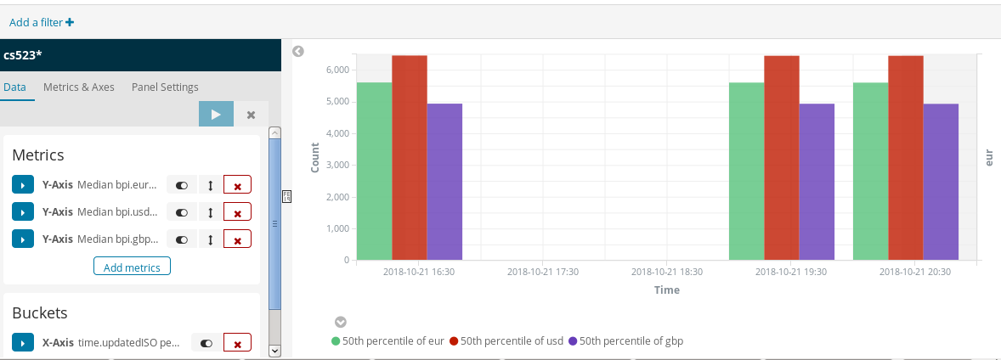
Per hour Avg Rate of each currency against BTC
Bar Chart

Slide 12
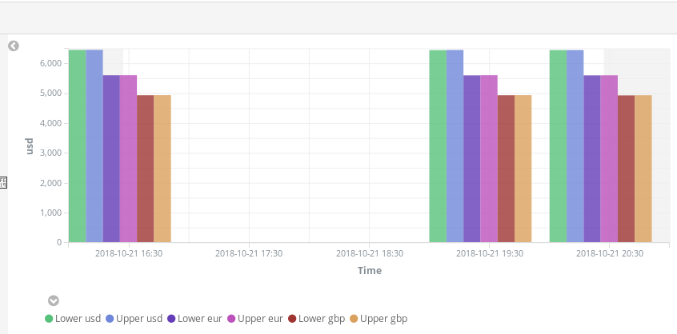
Per hour Min and Max Rate of each currency against BTC
Bar Chart

Slide 13
Per hour Min and Max Rate of each currency against BTC
Bar Chart

Slide 14
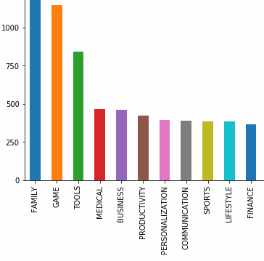
Project 2
Analysis of Google Play Store Data

Slide 15






Technologies

Slide 16
Workflow
Get data from kaggle
Load data into hdfs
Create Hive database and external tables
Use Spark SQL (pyspark library) to analyze data structured using Hive
Visual illustration of results using jupyter

Slide 17
Spark SQL is Fast
Much faster than Hive SQL
Runs on top of Spark core while Hive runs on top of MR
Spark core is faster than MR
Spark core stores intermediary results in memory while MR writes them to disk
Good for low latency applications

Slide 18
Spark SQL and Hive Integration
Hive stores metadata about tables in a metastore
Metastore is a database (derby or mysql)
Spark connects to hive metastore using thrift server
Thrift server in hive allows remote clients to execute queries against hive metastore and receive results via RPC

Slide 19
Thank you!
Q&A?

